Slide 1
CPUs
Example: data compressor.

Slide 2
Goals
Compress data transmitted over serial line.
  Receives byte-size input symbols.
  Produces output symbols packed into bytes.
Will build software module only here.

Slide 3
Collaboration diagram for compressor
1..m: packed
output
symbols
1..n: input
symbols
:input
:data compressor
:output

Slide 4
Huffman coding
Early statistical text compression algorithm.
Select non-uniform size codes.
  Use shorter codes for more common symbols.
  Use longer codes for less common symbols.
To allow decoding, codes must have unique prefixes.
  No code can be a prefix of a longer valid code.

Slide 5
Huffman example
character P
a .45
b .24
c .11
d .08
e .07
f .05
P=1
P=.55
P=.31
P=.19
P=.12

Slide 6
Example Huffman code
Read code from root to leaves:
a 1
b 01
c 0000
d 0001
e 0010
f 0011

Slide 7
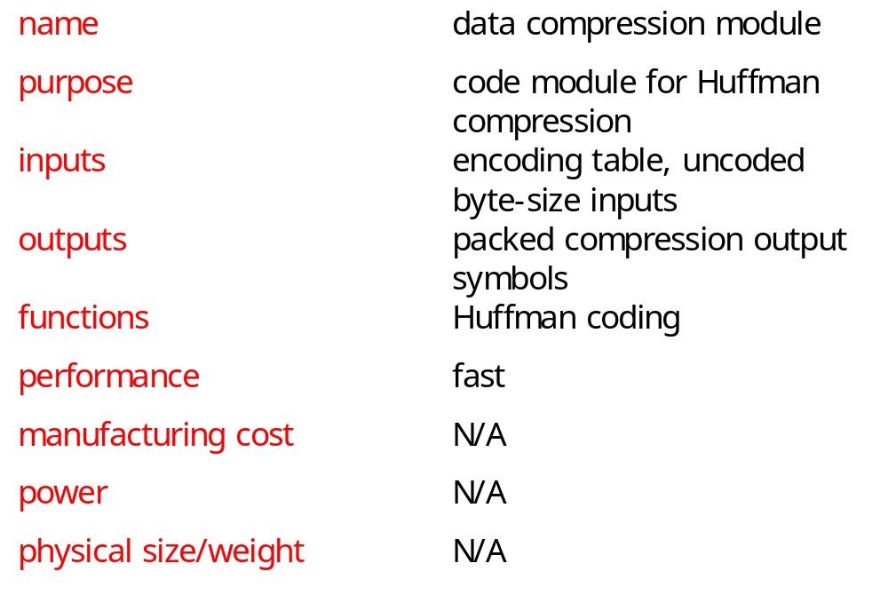
Huffman coder requirements table

Slide 8
Building a specification
Collaboration diagram shows only steady-state input/output.
A real system must:
  Accept an encoding table.
  Allow a system reset that flushes the compression buffer.

Slide 9
data-compressor class
data-compressor
buffer: data-buffer
table: symbol-table
current-bit: integer
encode(): boolean,
data-buffer
flush()
new-symbol-table()

Slide 10
data-compressor behaviors
encode: Takes one-byte input, generates packed encoded symbols and a Boolean indicating whether the buffer is full.
new-symbol-table: installs new symbol table in object, throws away old table.
flush: returns current state of buffer, including number of valid bits in buffer.

Slide 11
Auxiliary classes
data-buffer
symbol-table
databuf[databuflen] :
character
len : integer
symbols[nsymbols] :
data-buffer
len : integer
insert()
length() : integer
value() : symbol
load()

Slide 12
Auxiliary class roles
data-buffer holds both packed and unpacked symbols.
  Longest Huffman code for 8-bit inputs is 256 bits.
symbol-table indexes encoded verison of each symbol.
  load() puts data in a new symbol table.

Slide 13
Class relationships
data-compressor
1
1
1
1
data-buffer
symbol-table

Slide 14
Encode behavior
create new buffer
add to buffers
return true
T
input symbol
encode
buffer filled?
F
add to buffer
return false

Slide 15
Insert behavior
pack into
this buffer
input
symbol
T
update
length
fills buffer?
F
pack bottom bits
into this buffer,
top bits into
overflow buffer

Slide 16
Program design
In an object-oriented language, we can reflect the UML specification in the code more directly.
In a non-object-oriented language, we must either:
  add code to provide object-oriented features;
  diverge from the specification structure.

Slide 17
C++ classes
Class data_buffer {
char databuf[databuflen];
int len;
int length_in_chars() { return len/bitsperbyte; }
public:
void insert(data_buffer,data_buffer&);
int length() { return len; }
int length_in_bytes() { return (int)ceil(len/8.0); }
int initialize();
...

Slide 18
C++ classes, cont’d.
class data_compressor {
data_buffer buffer;
int current_bit;
symbol_table table;
public:
boolean encode(char,data_buffer&);
void new_symbol_table(symbol_table);
int flush(data_buffer&);
data_compressor();
~data_compressor();
}

Slide 19
C code
struct data_compressor_struct {
data_buffer buffer;
int current_bit;
sym_table table;
}
typedef struct data_compressor_struct data_compressor,
*data_compressor_ptr;
boolean data_compressor_encode(data_compressor_ptr mycmptrs, char isymbol, data_buffer *fullbuf) ...

Slide 20
Testing
Test by encoding, then decoding:
symbol table
input symbols
encoder
decoder
result
compare

Slide 21
Code inspection tests
Look at the code for potential problems:
  Can we run past end of symbol table?
  What happens when the next symbol does not fill the buffer? Does fill it?
  Do very long encoded symbols work properly? Very short symbols?
  Does flush() work properly?

